Slide 1
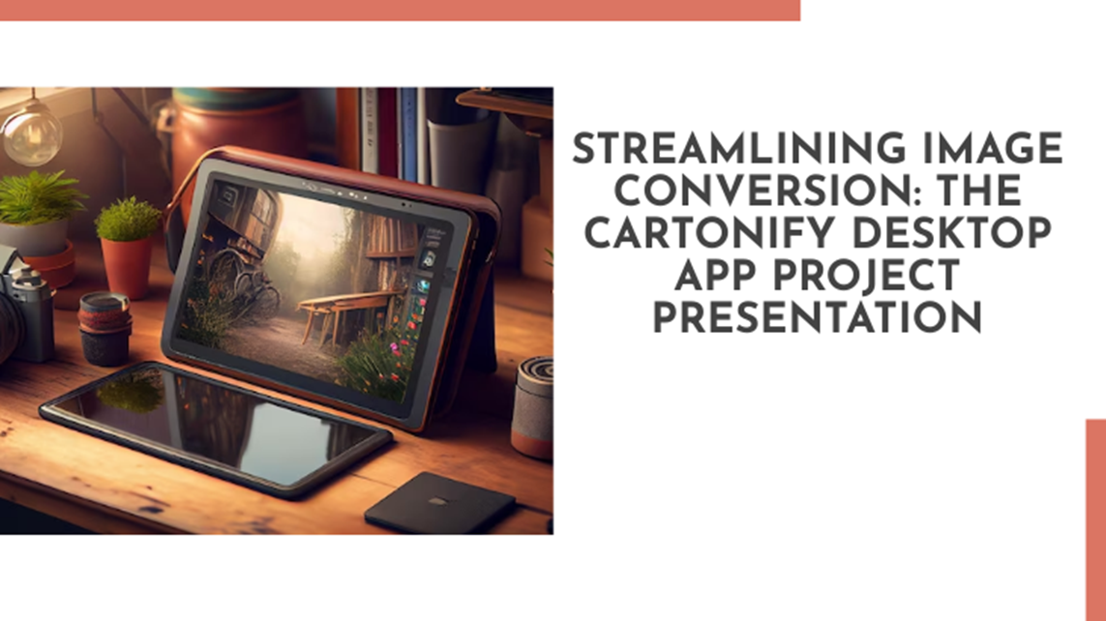
Submitted by:
Nur Afsari Nowrin
ID: 1914555014
Jhuma Amin
ID: 2014755028
Mostafa Faisal
ID: 2014755010
Md. Emon Hossain
ID: 2114955007

Slide 2
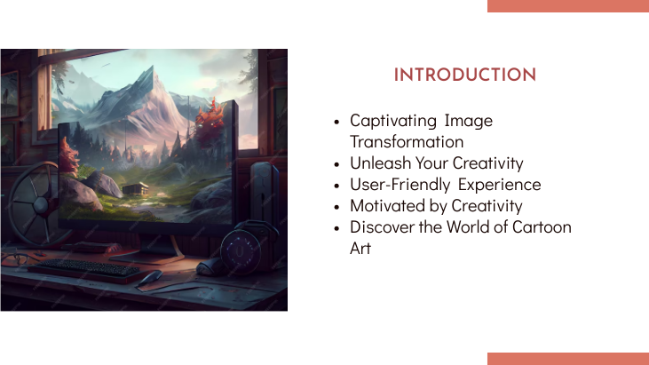

Slide 3
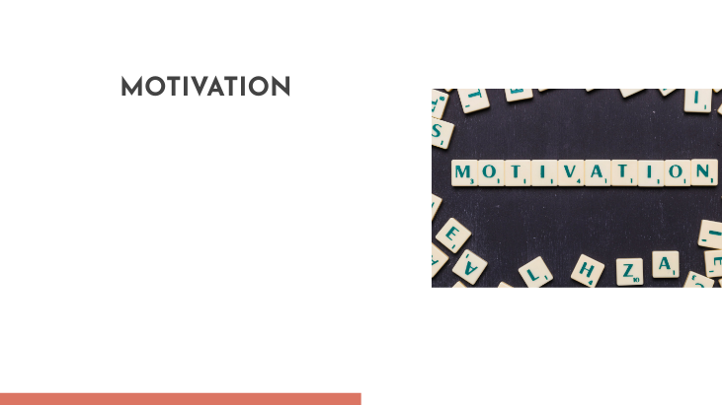
Expressive Visual Creativity
Popular Trend in Visual Content
Merge Technology and Artistry
Fun and Playful User Experience
Empowering Users to Stand Out

Slide 4
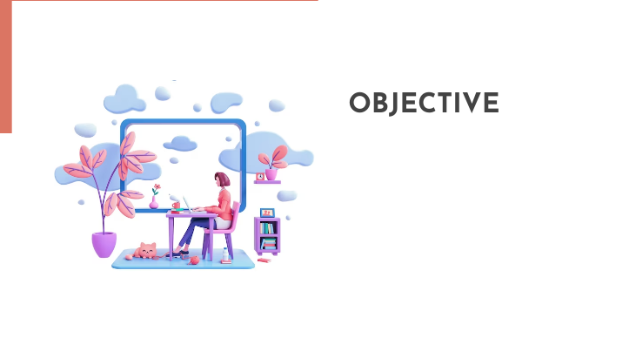
Enable Effortless Cartoonification
Expand Creative Possibilities
User-Friendly Interface
Optimize Processing Speed
Facilitate Interaction and Sharing

Slide 5
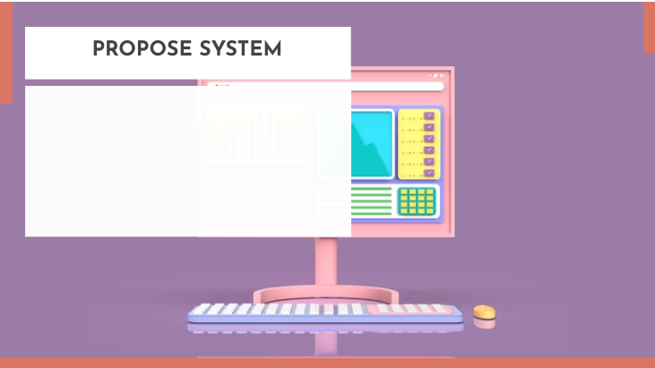
Intuitive Image Upload
Real-Time Cartoonification Engine
Interactive User Interface
Save and Share Functionality

Slide 6
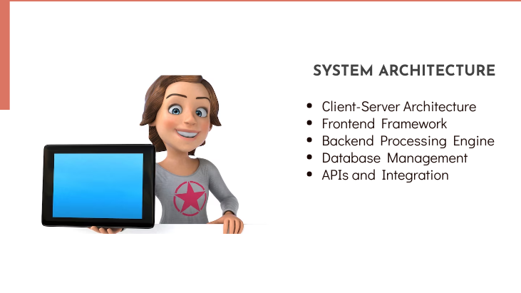
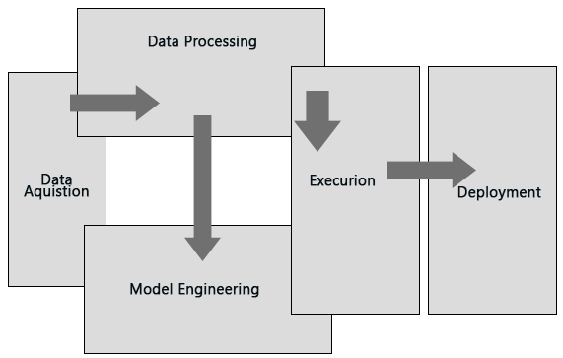

Slide 7
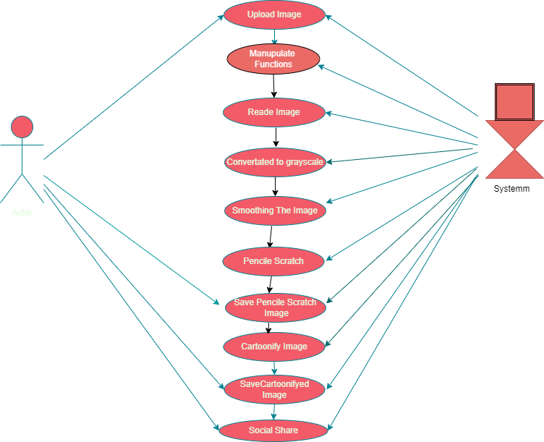
User Case(UML)Diagram

Slide 8
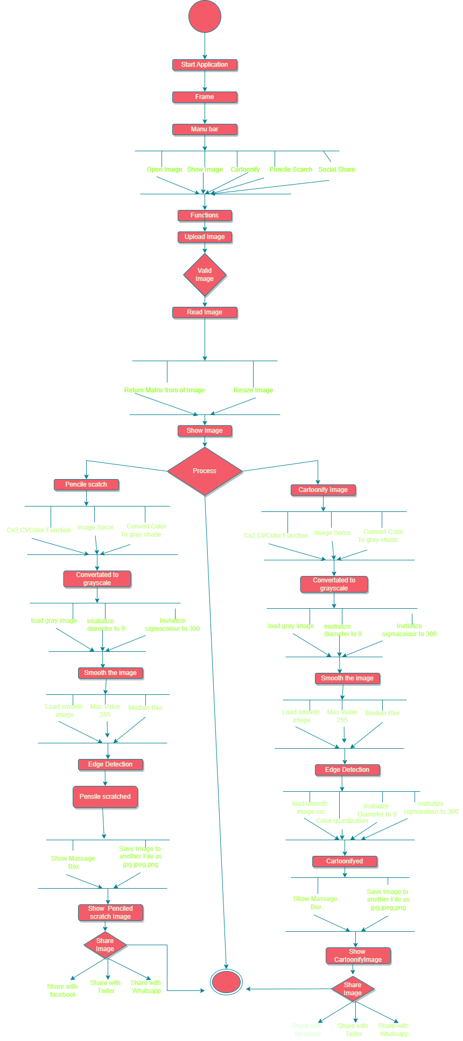
Activity Diagram

Slide 9
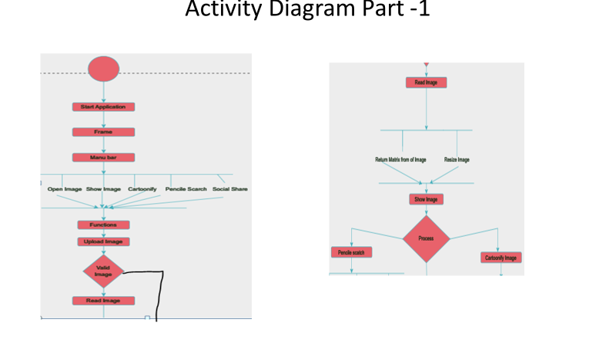

Slide 10
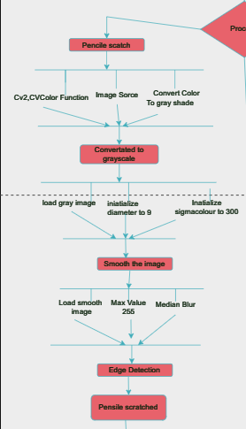
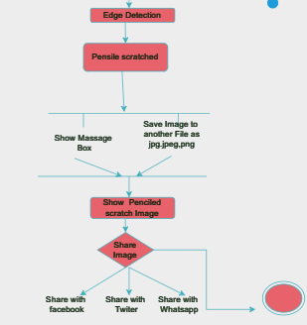
Activity Diagram Part -2

Slide 11
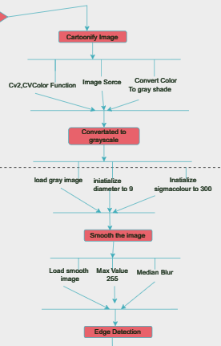
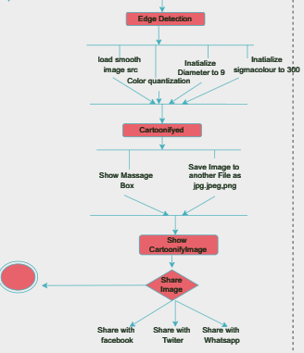
Activity Diagram Part -3

Slide 12
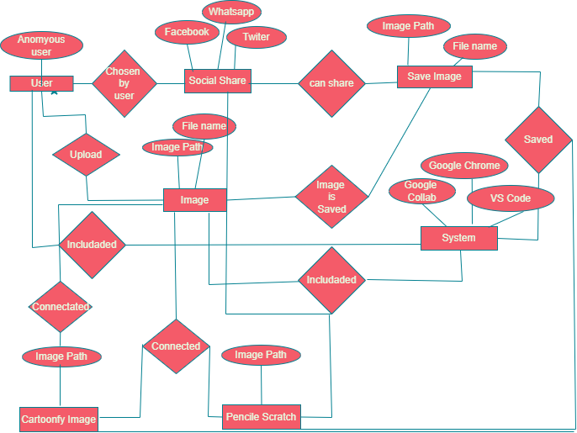
ER Diagram

Slide 13
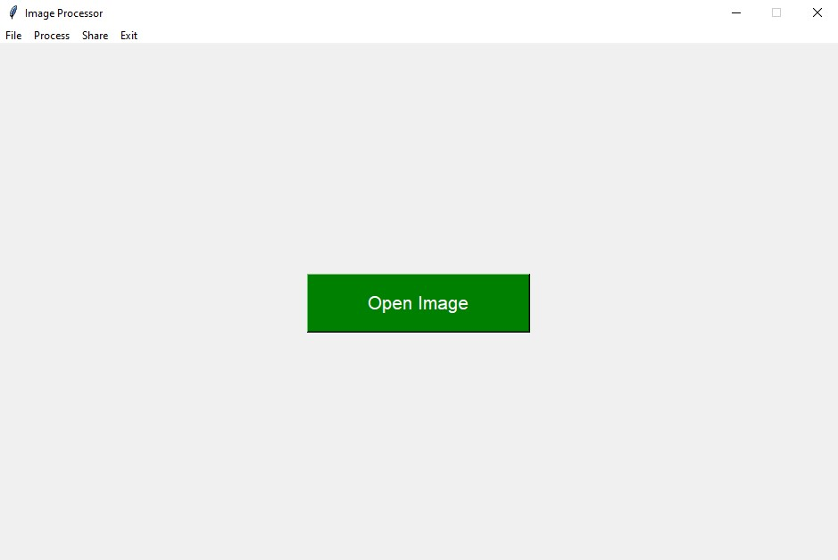
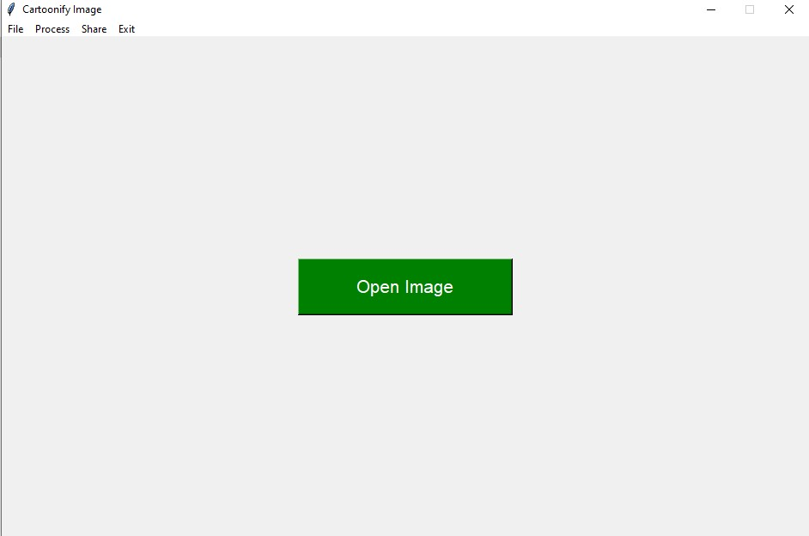

Slide 14
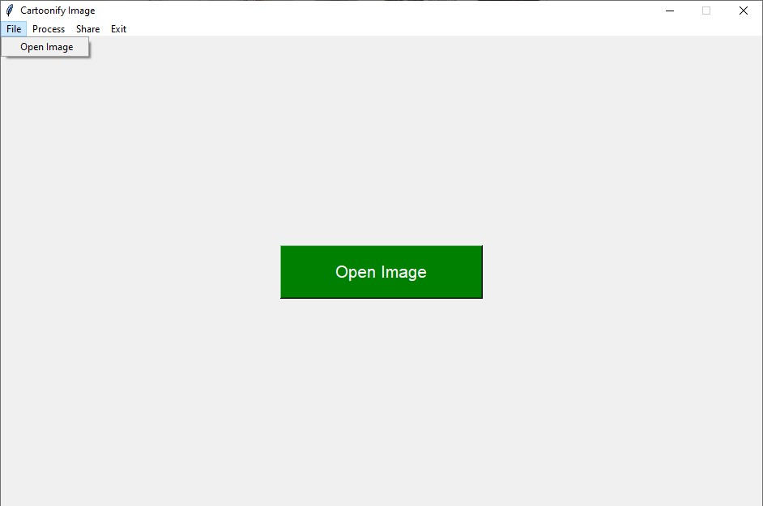

Slide 15
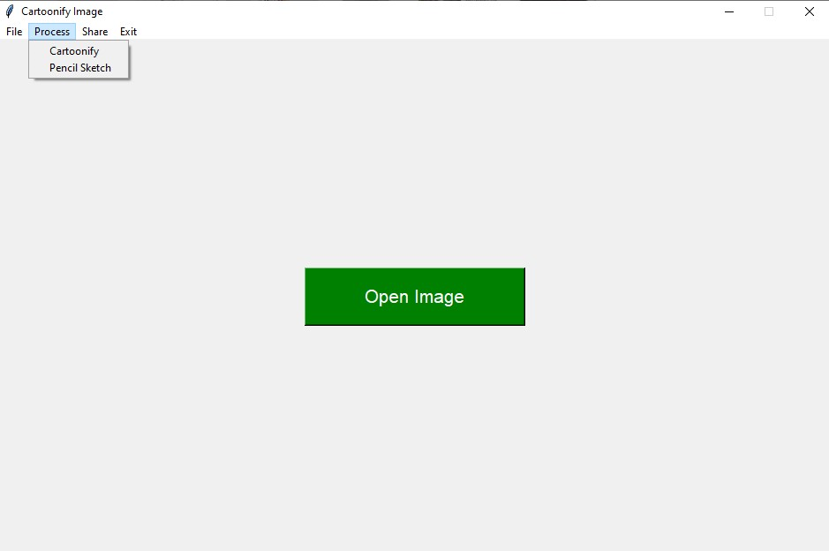

Slide 16
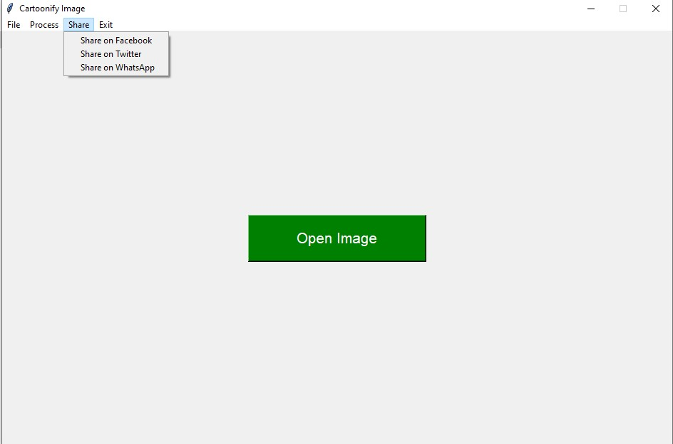

Slide 17
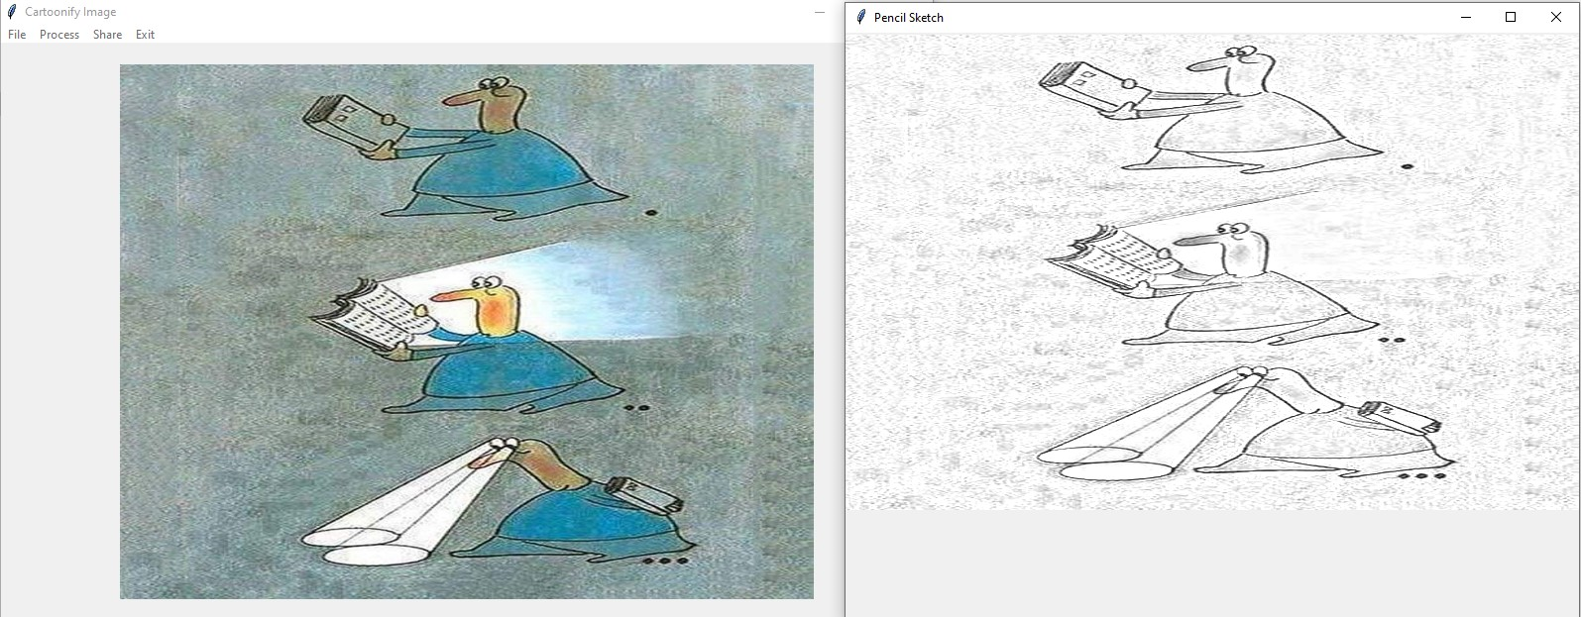

Slide 18
Conclusion
This project demonstrates how to create a basic cartoonify image application using Python , Pandas and various libraries. It can be further improved by adding additional features, such as parameter adjustments for different cartoon styles and support for batch processing of multiple images.
We are aiming to add this project in robotics in the future. Overall, this project is a useful starting point for anyone interested in image processing and creating interactive applications for applying creative effects to images.

Slide 19


